Slide 1
Tech Gadgets and its Brand Perception
Subject : Predictive Analytics Lab
Guide : Dr.E.Chandra Blessie
MEMBERS:
Hari Nitharsan S B – 2033014
Vidhya Varshany J S - 2033038

Slide 2
Problem Statement
Each of the technological gadgets is available in a variety of brands.
In this modern era, it is difficult to determine which brand a customer should purchase based on their preferences, so clustering analysis and PCA analysis are used to classify the brand based on the characteristics and standard features shared by each brand.

Slide 3
Objective
To classify the data based on the characteristic similarity
To identify the variables having greatest impact on various brands

Slide 4
Data Set
Different brands of tech gadgets with various features are chosen for analysis
Samples – 119 entries , 11 columns
Gadgets names – Smartphone, Mouse Keyboard, Headphone Camera and Laptop
Gadget: Smartphone

Slide 5
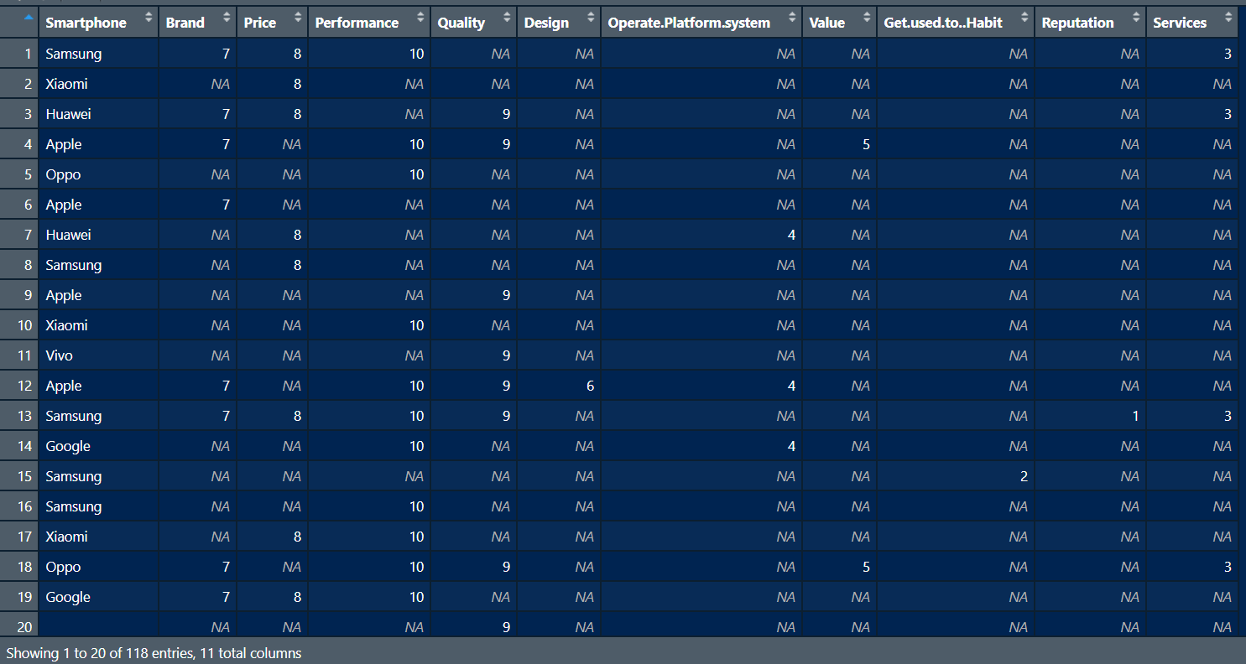

Slide 6
Tools / Techniques Used
Language Used : R
Tools
Data collection– Type Form
Data Analysis - R Studio
Techniques
Clustering (K- Means)
Principle Component Analysis (PCA)

Slide 7
Thanks!

